Slide 1
Applied Software Security
Lecture 3
ARM (AArch64) Intro

Slide 2
ARM - a brief overview
Up till now, we have focused on the intel x86-64 architecture.
Today we will overview the ARM architecture - or rather it’s 64 bit version:
AArch64 (which includes a 64 bit execution mode (A64) and a 32 bit execution mode (A32) which is compatible with the (previous) 32 bit ARM architecture).
We will be much less thorough then for x86(-64), as many of the concepts are
common.
A bit about ARM:
One of the most popular architectures.
Used in many embedded devices.
A RISC (reduced instruction set) processor -
less instruction, simpler instructions, data processing only on registers. Instructions are of fixed length, and rather simple encoding. Many registers. Easier to learn (at least in my opinion).
There is a “link register” (we will describe in the A64 overview).
Can be big/little endian (configurable).

Slide 3
ARM - 32 bit architecture (A32 - ARM compatibility mode)
16 GPRs (32 bit) named R0-R15, some with another name (those with special use):
R15 - pc, R14 - link register, R13 - sp, R11 - fp (frame pointer, similar to ebp).
CPSR - the flags register. Part of the “state info” stored in PSTATE register.
All instructions (in ARM mode, see below) contain a condition field, and are conditionally executed accordingly.
Some (more) operations can be preformed on pc.
There are two execution modes, indicated by the “T bit” in CPSR: ARM and THUMB (pun intended):
In ARM all instructions are 32 bit in length.
In THUMB all instructions are 16 bit in length (some instructions though are a “stream of 2” 16 bit instruction) - less functionality, but smaller code size.
An example walkthrough the A32 (ARM mode) encoding from the reference:

Slide 4
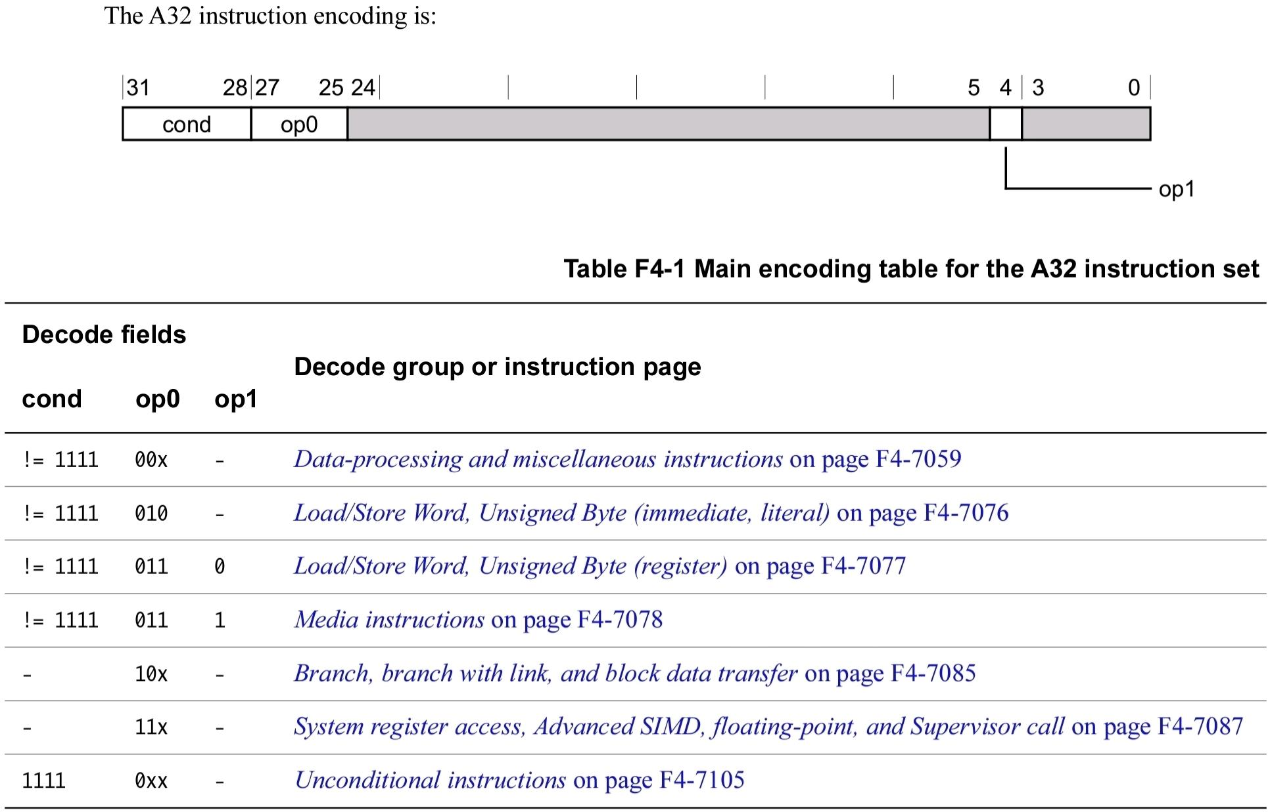

Slide 5
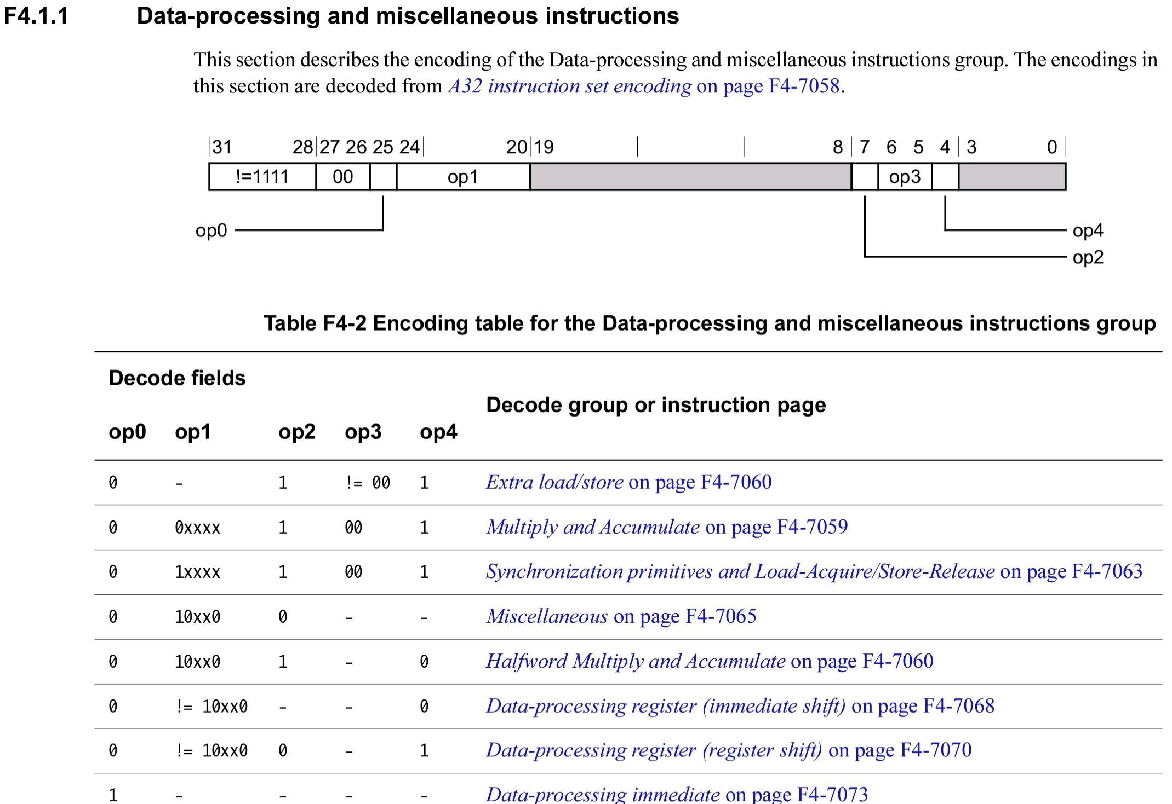

Slide 6
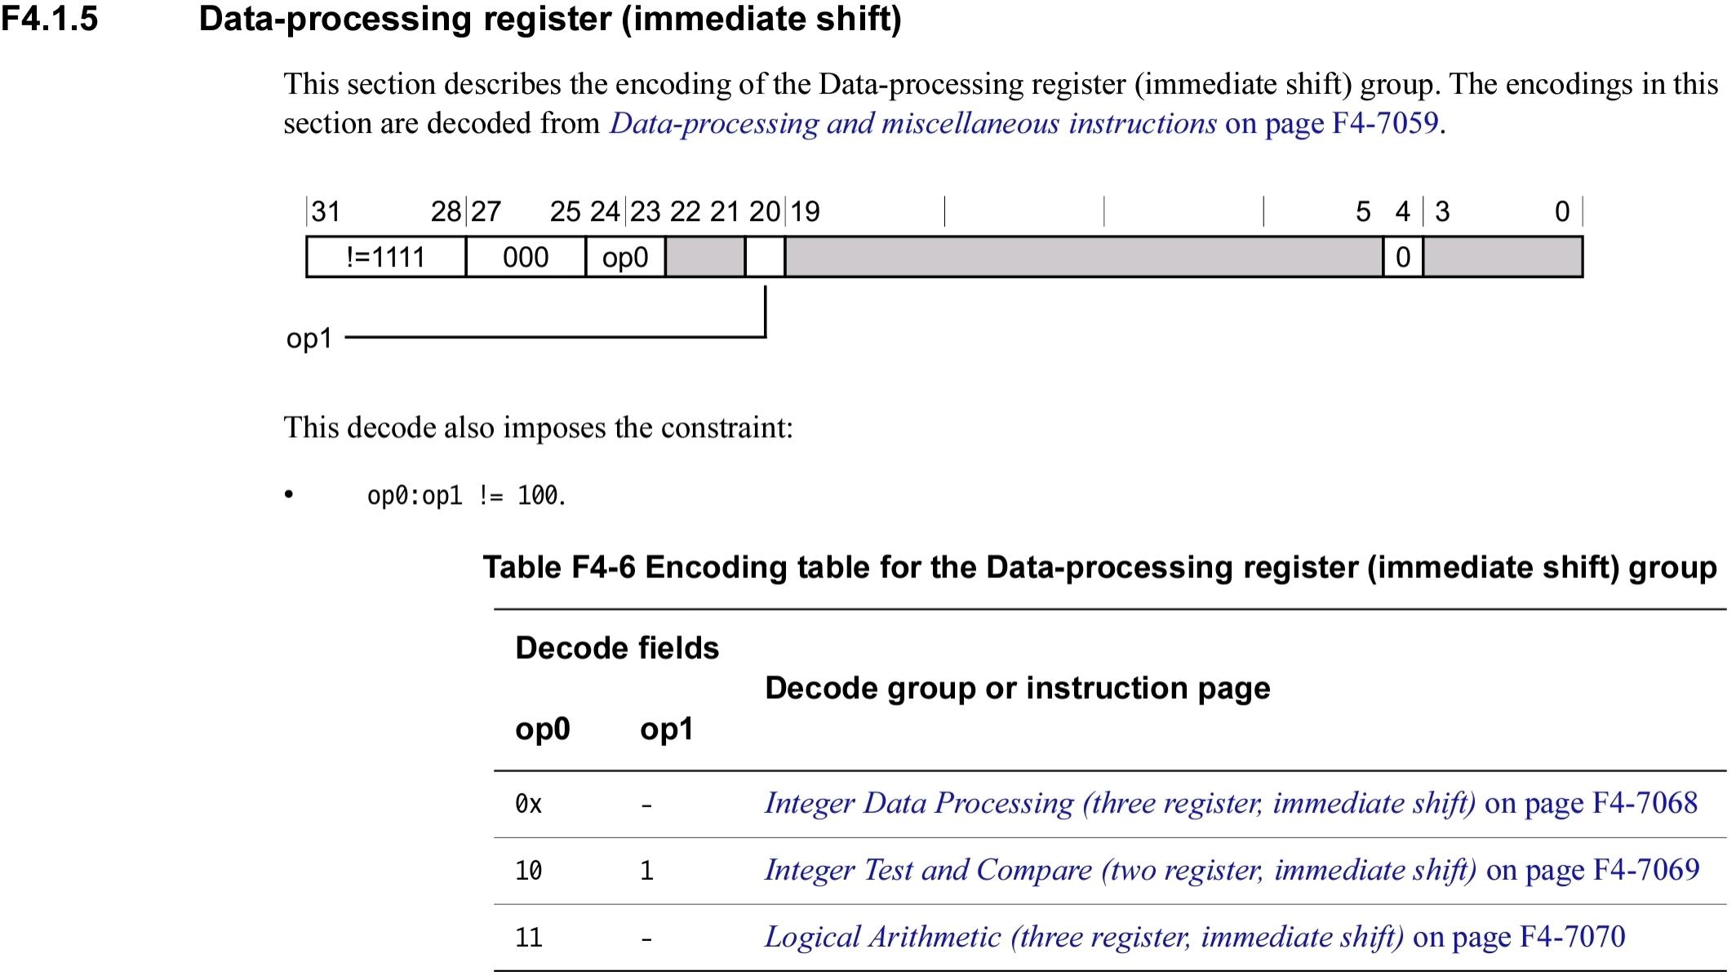

Slide 7
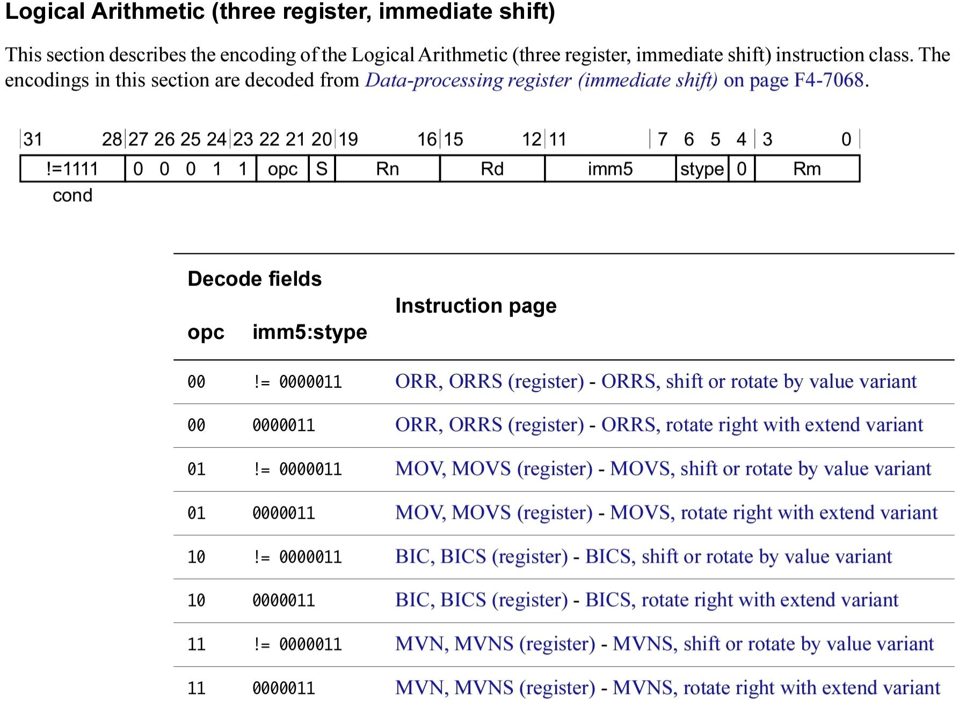

Slide 8
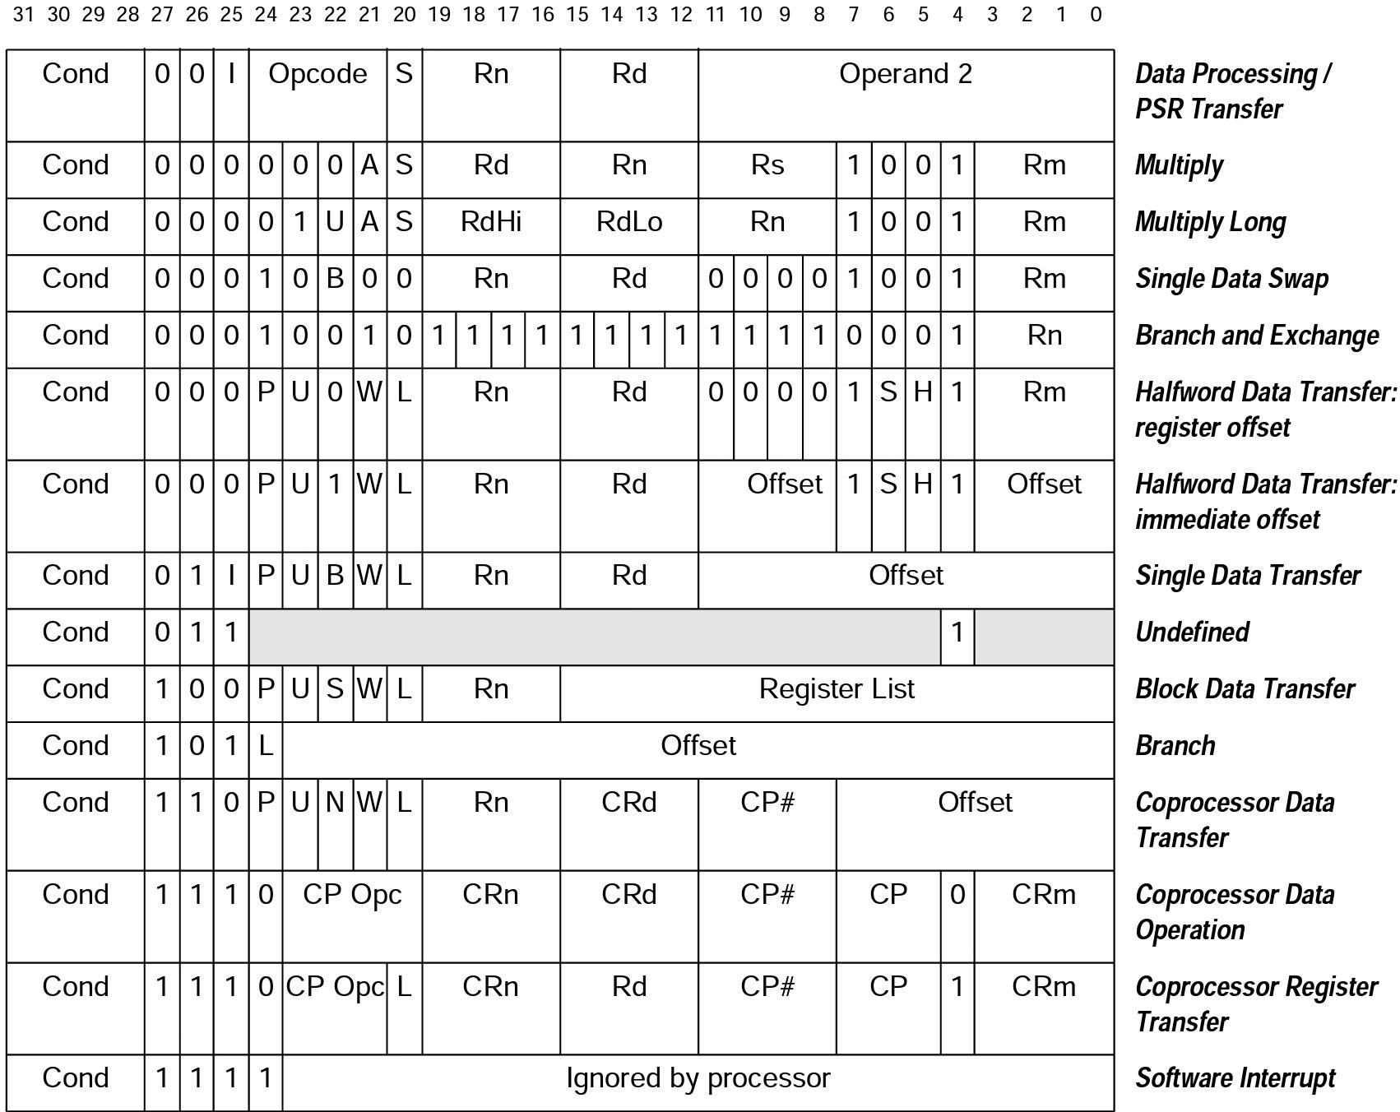
A summed up table of some instructions

Slide 9
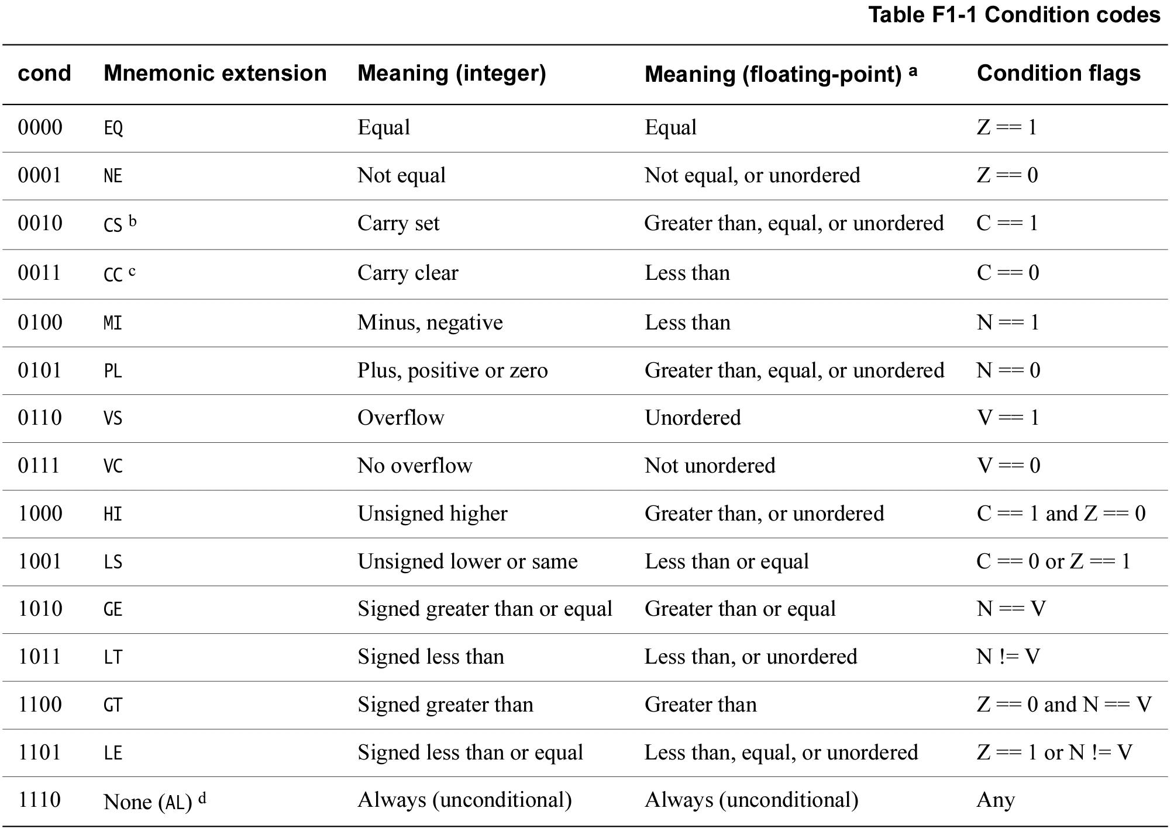

Slide 10
ARM - 32 bit architecture (A32 - ARM compatibility mode)
In THUMB mode:
No shifts in opcode
Some instructions do not have a condition field
To operate on 32 bit operands, an instruction is broken into 2 16 bit instructions (“a stream of 2 16 bit instructions”).
Switching between ARM and THUMB mode is done by calling branch (with link) and exchange (B(L)X) which switches modes according to the lowest bit of the address: 0 - ARM mode, 1 - THUMB mode.
That is BX offset & -2 | [0 / 1] => branch to offset & -2 in [ARM / THUMB] mode respectively.

Slide 11
ARM - a brief overview of the 64 bit architecture (A64)
31 GPRs (64 bit) named R0-R30, entire registers referenced as X0-X30, lower half referenced as W0-W30. R30 is also the link register (LR).
PC dedicated register (not Rn) and no longer accessible as GPR, SP also dedicated.
PSTATE machine state register (contains the flags and more).
Most instructions do not contain a condition field.
Many instructions contain both a 32/64 bit operand mode (use 32 bit registers or 64 ones, indicated by the sf bit in the instruction).
Instructions are of fixed 32 bit length, can take 64 bit arguments. To use (specific) 64 bit immediates, possibly 2 instructions are used.
Summed up instruction format table:

Slide 12
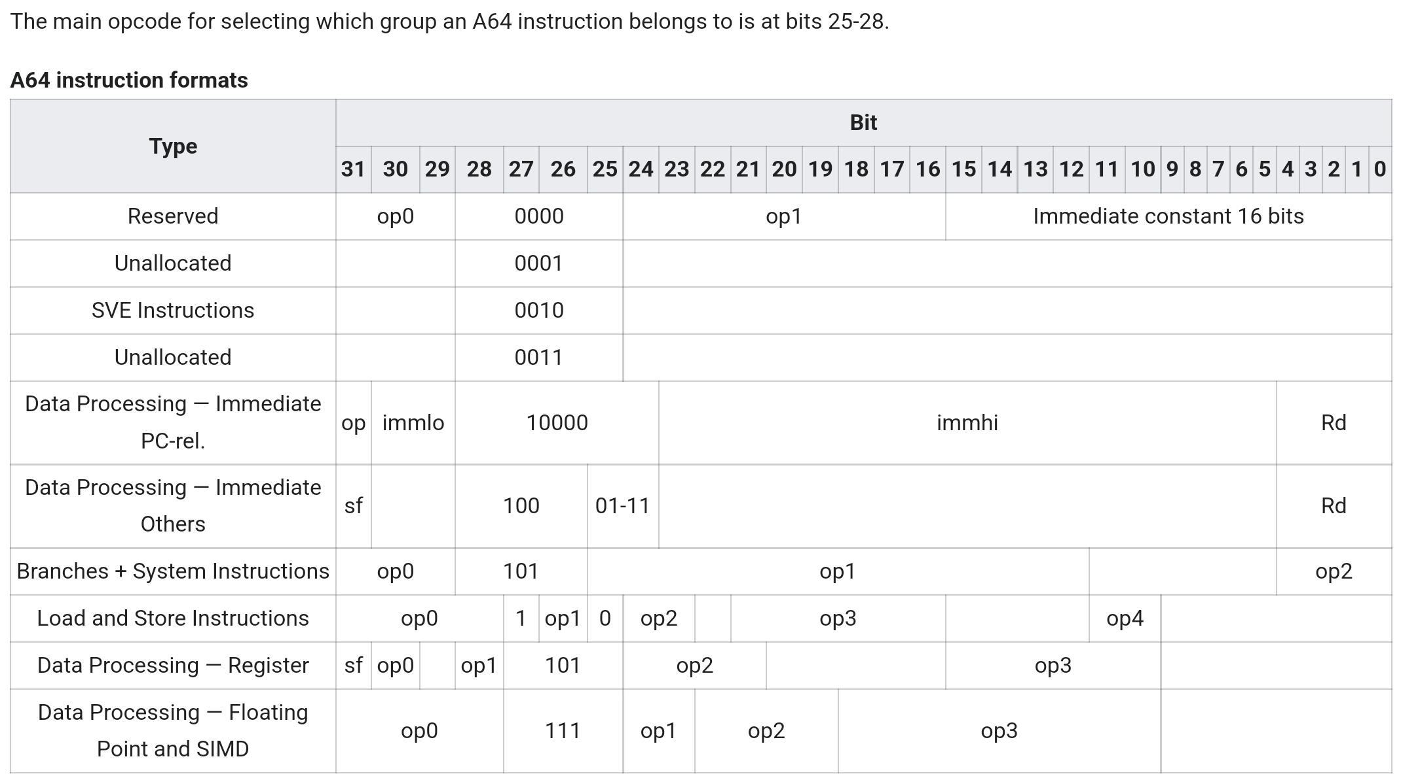

Slide 13
Link Register
A register that can be used to store the return address from a call using a specific instruction - branch with link.
Branch with link (BL) to an address X will store the address of the next instruction after the branch in the link register (LR (R14 / X30)) and set pc to X.
A regular branch (B) will only transfer control to the target address without changing LR (like jmp in x86/-64).
The link register enables fast calls tou small routines that does not access the memory (does not push anything on the stack).
If there are nested calls, the link register is just pushed and poped (in A32 can be directly to pc) when returning from the function:

Slide 14
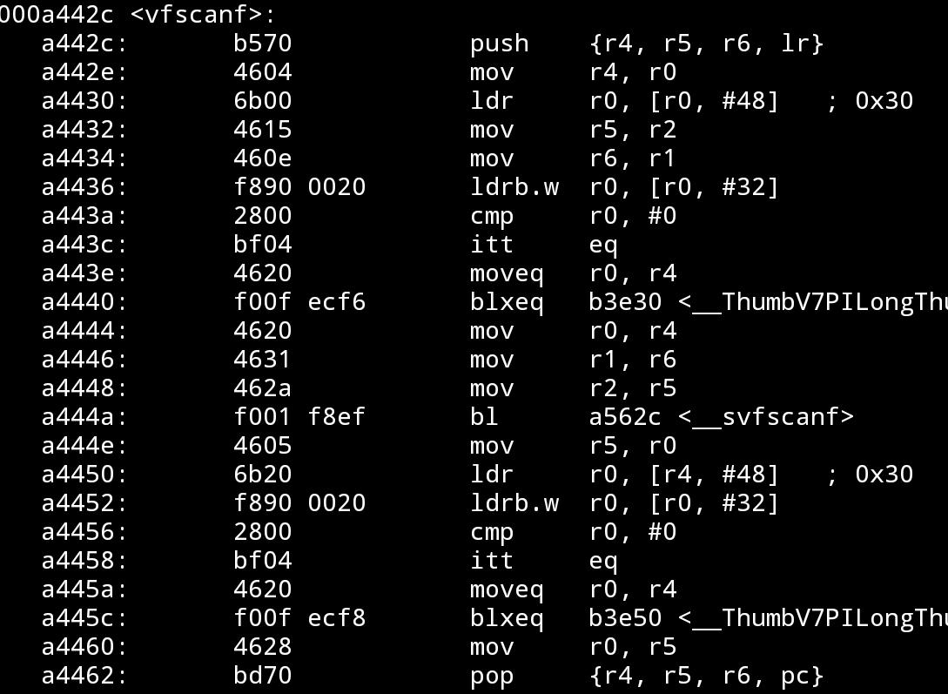
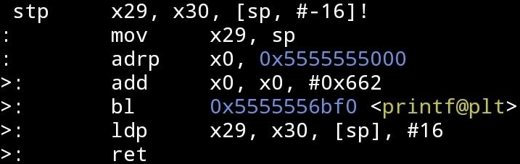
Link Register
A32 A64

Slide 15
PSTATE and CPSR (flags)
Contains information about the current execution state such as:
condition flags
execution mode (32/64, in 32 Thumb/ARM/Jazelle, interrupt/etc mask bits).
access control information (pan, uao)
privileged information (exception level)
exception mask bits
data processing related information (e.g. endiannes)
In AArch64 PSTATE:
some fields can be accessed only in privileged execution levels (more on EL soon).
some fields can be accessed only indirectly.
some fields can be accessed directly via special system registers via MRS/MSR (system register read/write) instructions.

Slide 16
PSTATE and CPSR (flags)
In ARM PSTATE:
Similar to 64 bit. Different fields of PSTATE are accessible via special registers depending on the execution level (grouped together as: for EL0 APSR, for EL>1 CPSR).

Slide 17
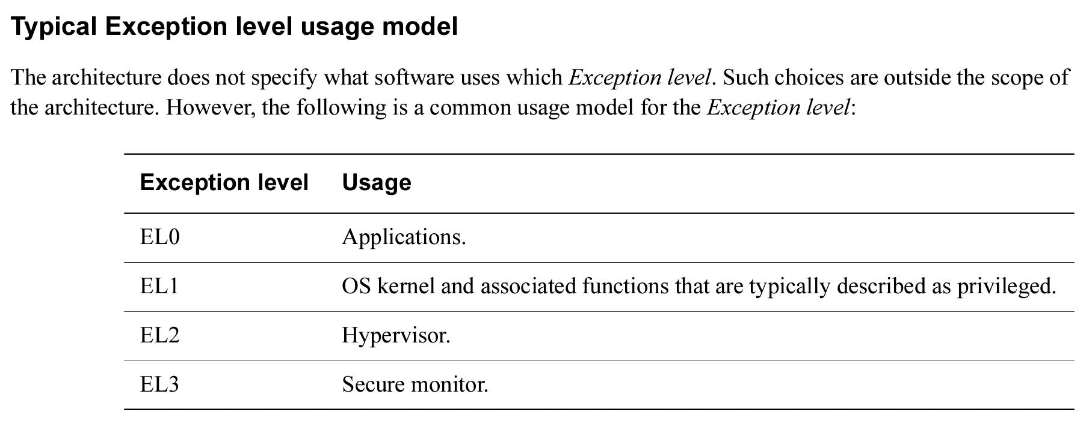
Exception Levels - In AArch64 (overview)
In AArch64 (and ARM) the execution state contains an exception level ELn for 0<=n<=4, where for n<m code executing in ELn is considered less privileged then code executing in ELm.
Typically the seperation is more or less:

Slide 18
Exception Levels - In AArch64 (overview)
Not all levels are required to be implemented.
Each exception level has a dedicated stack pointer SP_ELn. When executing in ELn for n>0, the PSTATE.SP bit indicates whether to operate on SP_EL0 or SP_ELn.
Each exception level to which an exception can be made (n>0) has a dedicated Saved Program Status Register SPSR_ELn for saving the PSTATE of the code generating the exception.
Each exception level to which an exception can be made (n>0) has a dedicated Exception Link register ELR_ELn which hold the preferred exception return address (the address to which the exception handling code should return, depending on the type of exception could be the address of the instruction generating it (or the instruction after).
Exceptions that are generated as a result of an execution of an instruction / attempt to execute an instruction are called synchronous. Other ones are called asynchronous, and also Interrupts.

Slide 19
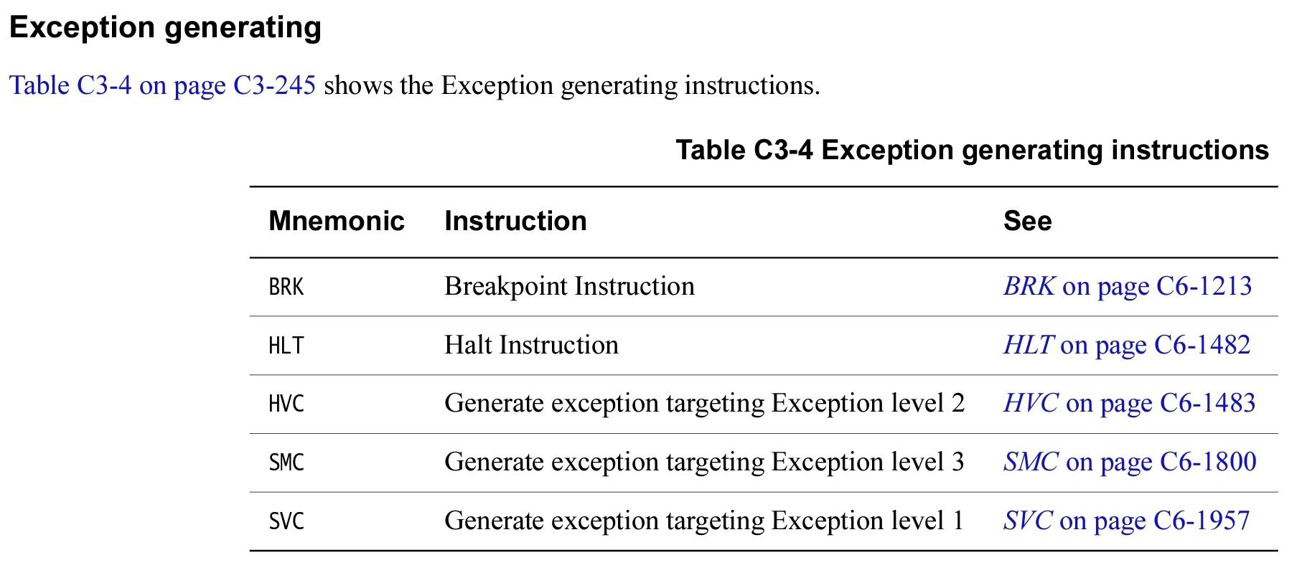
Exception Levels - In AArch64 (overview)
Exception generating instructions:
The target exception levels of exception (also those that are not generated by dedicated instructions) are determined by predefined rules and configurations stored in system registers

Slide 20
Exception Levels - In AArch64 (overview)
When an exception is taken (occurs) to ELn (roughly):
The content of PSTATE from immediately before the exception was taken is stored in SPSR_ELn.
The preferred exception return address (depending on the type of exception) is stored in ELR_ELn.
PSTATE is initialized with some default values in some fields and with PSTATE.EL=n.
For synchronous exceptions the “Exception Syndrom” information (information about the exception) is written in ESR_ELn.
Execution starts from the exception vector of the exception level (will describe soon).
When an exception at exception level n is returned from (using ERET / ERETAA / ERETAB) instructions (under most circumstances) (roughly):
PC is set to the value in ELR_ELn.
PSTATE is set to the value at SPSR_ELn.

Slide 21
Exception Levels - Exception Vectors
Describe where execution should start when taking an exception.
Described by VBAR_ELn which contains the exception vector address for each target exception level.
For every subtype of exception there is handling code at a predefined offset from the exception vector address:

Slide 22
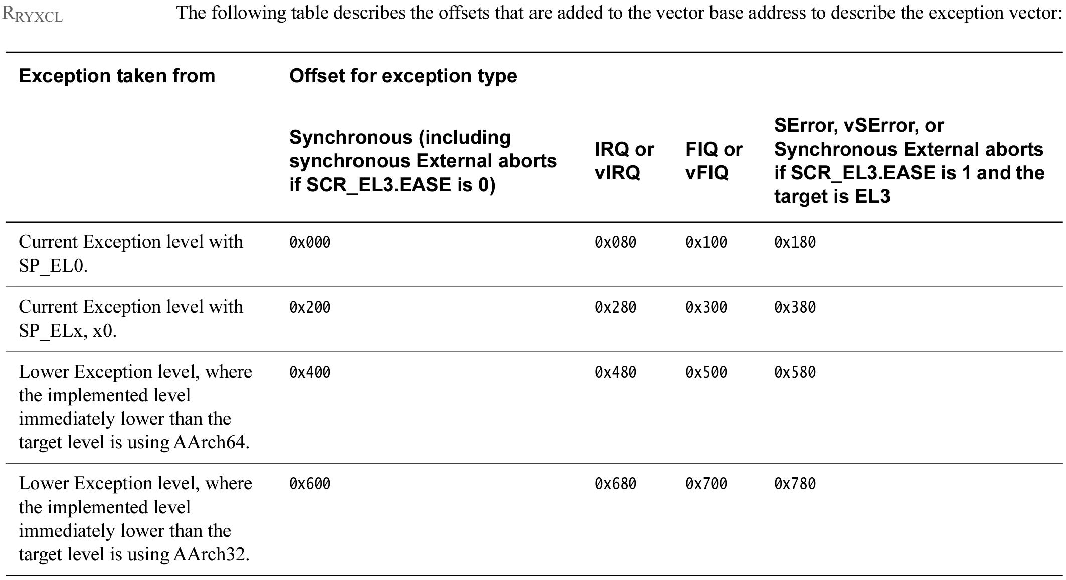
Exception Levels - Exception Vectors

Slide 23
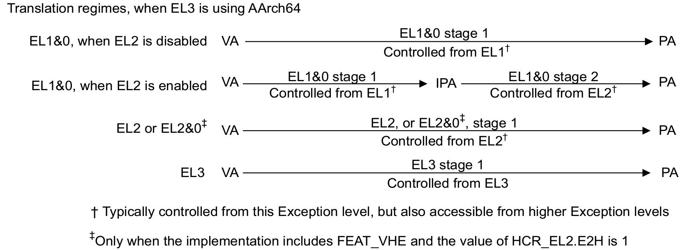
Memory translation, Privileges - AArch64 (very brief overview)
AArch64 defines several regimes (schemes) of address translation which are chosed depending on system control register configurations most of which we will not go into. A partial picture:

Slide 24
Memory translation, Privileges - AArch64 (brief overview)
Some of the regimes (in some exception levels) have 2 levels of address translation: two stages of translation via page tables (VA (Virtual Address) -> IPA (Intermediate Physical address) -> PA (Physical address)) that are controlled in different exception levels. This way even the OS can’t see the real physical address under some regimes.
For a single stage of translation: The TTBR_ELn (Translation Table Base Register) indicates the start of the first translation table (“level 1 page table”).
The first stage (level) in the translation process in schemes supporting 2 stages, can operate on low and high memory using 2 different first level page tables (which are determined by system control registers TTBR0_ELn and TTBR1_ELn), translating a low high VA using the appropriate table.
Up to 4 levels of translation tables, of configurable granule 4/16/64K pages.
Some registers that take part in the address translation configurations: SCTLR_ELn, TCR_ELn, TTBR(0/1)_ELn.
Supports several input address (IA) sizes (48 bits, 52 bits….)

Slide 25
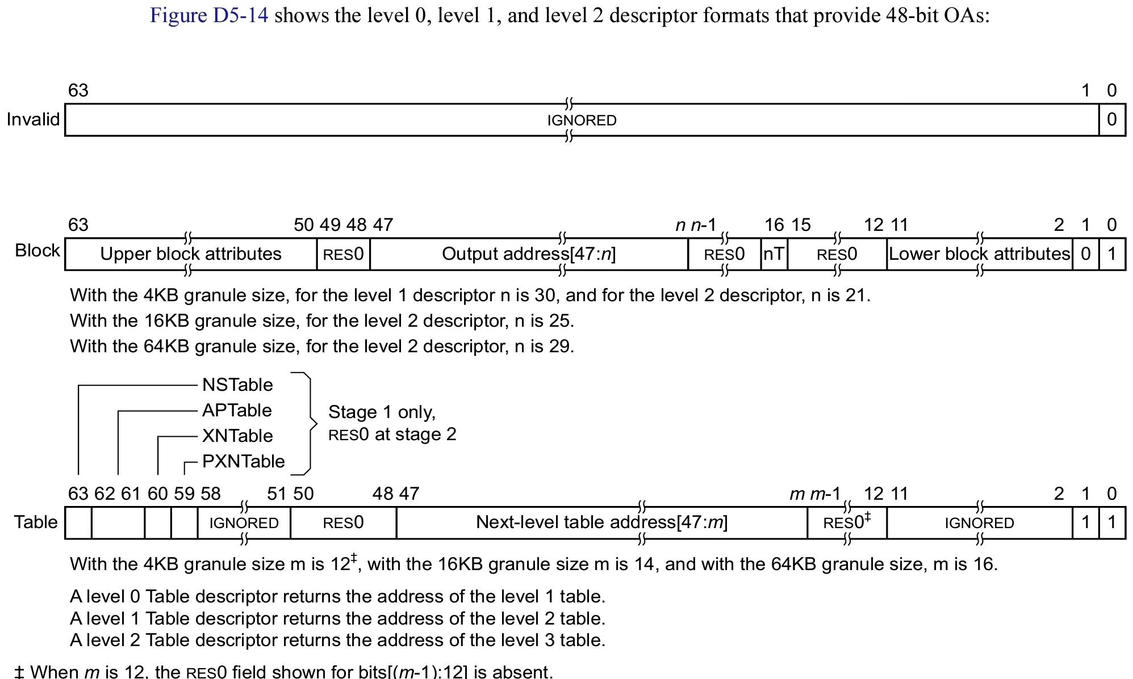
Memory translation, Privileges - AArch64 (brief overview)
Translation table entries format depend on the regime and other configurations. An example entry:

Slide 26
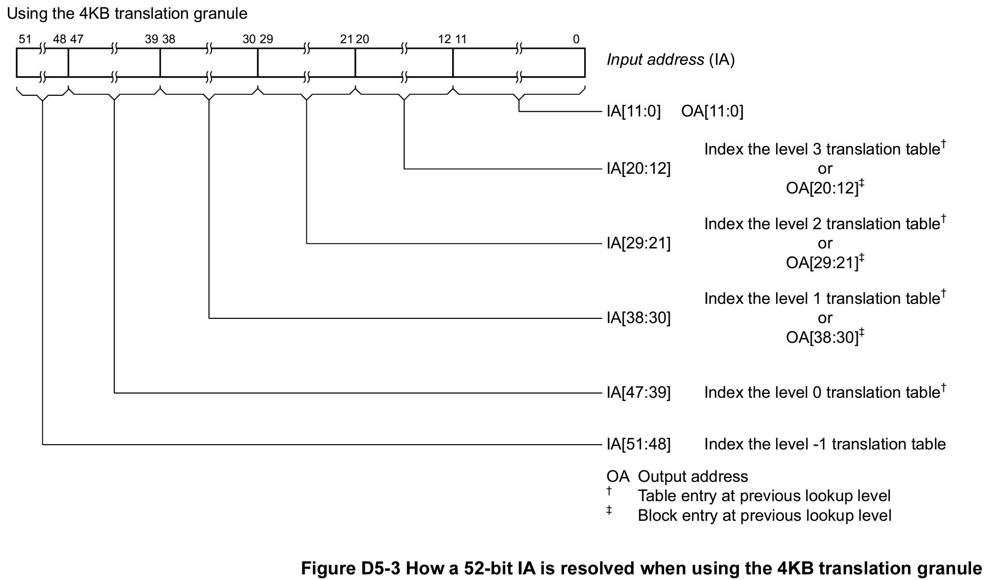
Memory translation, Priviliges - AArch64 (brief overview)

Slide 27
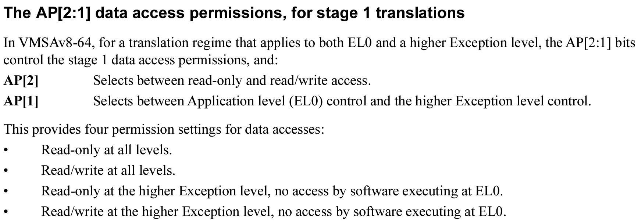
Memory translation, Privileges - AArch64 (brief overview)
Several mechanisms for privileges and permissions, some that solve some of the problems we’ve discussed before (in a translation table entry):

Slide 28
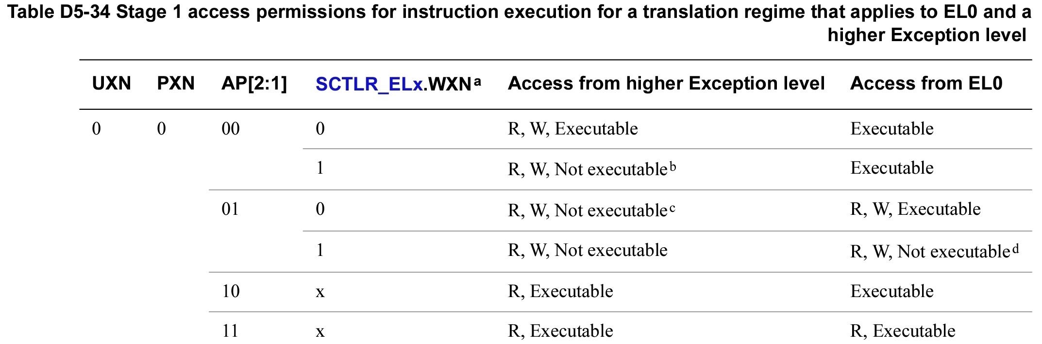
Memory translation, Privileges - AArch64 (brief overview)

Slide 29
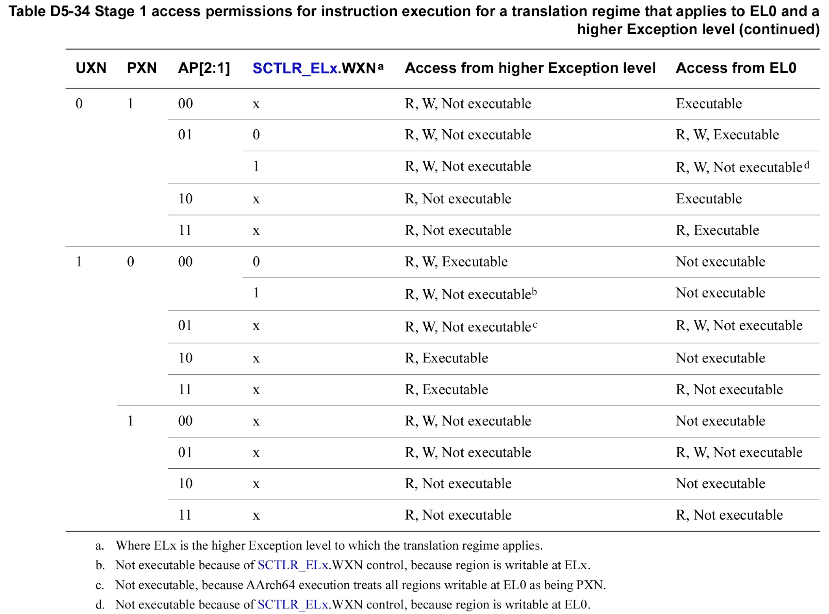
Memory translation, Privileges - AArch64 (brief overview)

Slide 30
Instruction set overview
To be determined

Slide 31
System calls
Implemented using the SVC instruction.
Contains an immediate to indicate the syscall number.
Taken in EL1 unless configured otherwise by special system registers.
Immediate (and the exception being a system call) recorded in ESR_ELn.

Slide 32
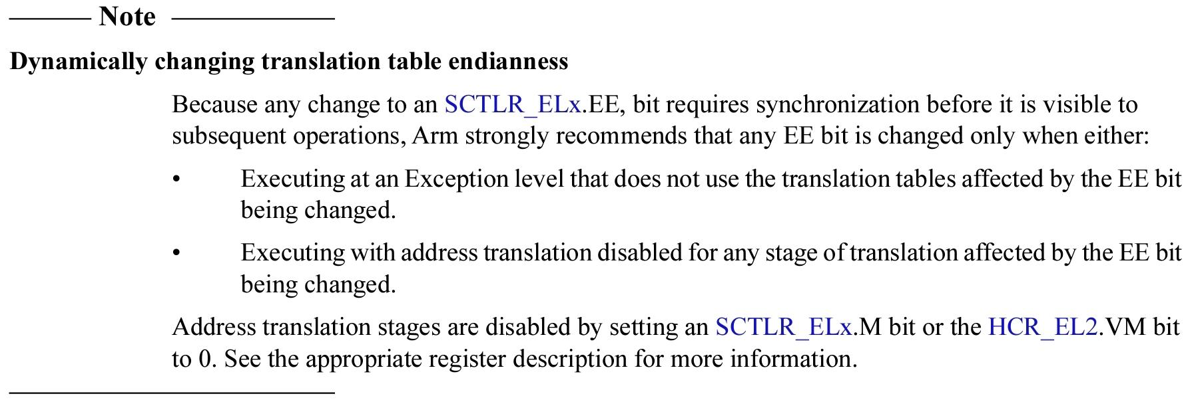
Notes - We:
Haven’t covered exceptions in ARM (32 bit).
Haven’t covered interprocessing behaviour - exceptions that trasfter from 32 to 64 bit! Memory translation for 32 vs 64 bit!
Haven’t covered many other execution state related things.
Haven’t covered many other “things”.

Slide 33
For more info see the manual at
https://developer.arm.com/documentation/ddi0487/latest
(it’s only 11530 pages)

